Slide 1
Selenium TestNG
2025
Poornima

Slide 2
Selenium TestNG
TestNG (Test Next Generation) is a testing framework inspired by JUnit but designed to be more powerful and flexible. When combined with Selenium WebDriver, it helps structure automation tests, manage execution flow, and generate detailed reports.
Key Features of TestNG with Selenium
Annotations (@Test, @BeforeClass, @AfterMethod, etc.) → Control test setup and teardown.
Grouping & Prioritization → Run specific sets of tests or control execution order.
Parallel Execution → Run tests across multiple browsers or environments simultaneously.
Data-driven Testing → Use @DataProvider or integrate with Apache POI for Excel-based test data.
Dependencies management – Use dependsOnMethods to manage Test dependencies
Reporting → Generates HTML/XML reports automatically after execution.

Slide 3
TestNG priority
In TestNG, prioritization means controlling the order in which your test methods run. By default, TestNG executes tests alphabetically by method name. When you assign a priority attribute to @Test, methods with lower priority numbers run first, giving you precise control over sequencing
How Prioritization Works
Default behavior: If no priority is set, TestNG runs tests alphabetically.
Priority attribute: You can assign @Test(priority = n) where n is an integer.
Lower values run first (priority=0 runs before priority=1).
Negative values are allowed (they run before 0).
Same priority: If multiple methods have the same priority, they run alphabetically.

Slide 4
TestNG Annotations
TestNG annotations are special markers/ metadata tags (like @Test, @BeforeClass, @AfterMethod) that control the execution flow of your Selenium tests. They tell TestNG when to run setup, test, and teardown methods, making automation structured and manageable
Annotation | Description | Example Usage
@BeforeSuite | Runs once before all tests in the suite | Initialize global resources
@AfterSuite | Runs once after all tests in the suite | Close global resources
@BeforeTest | Runs before any test method in tag | Setup browser
@AfterTest | Runs after all test methods in tag | Close browser
@BeforeClass | Runs before the first method in the class | Open application
@AfterClass | Runs after all methods in the class | Logout/close app
@BeforeMethod | Runs before each @Test method | Navigate to login page
@AfterMethod | Runs after each @Test method | Clear cookies
@Test | Marks a method as a test case | Actual test logic

Slide 5
TestNG Assertion
Assertions in TestNG are mechanisms used within test cases to validate that the actual outcome of a test matches the expected outcome.
They are crucial for determining whether a test passes or fails.
TestNG provides a rich set of assertion methods within the org.testng.Assert class.
Purpose:
To verify conditions and states within your application under test.
To compare actual results with expected results.
To determine the pass/fail status of individual test steps and the overall test case.

Slide 6
TestNG – Hard Assertion
These are the standard assertions provided by the org.testng.Assert class.
If a hard assertion fails, it immediately throws an AssertionError and terminates the execution of the current test method.
This is useful when a critical condition must be met before proceeding with further steps in a test
Assert.assertEquals(actual, expected): Checks if two values are equal.
Assert.assertNotEquals(actual, expected): Checks if two values are not equal.
Assert.assertTrue(condition): Checks if a condition is true.
Assert.assertFalse(condition): Checks if a condition is false.
Assert.assertNull(object): Checks if an object is null.
Assert.assertNotNull(object): Checks if an object is not null
Assert.fail() → Forces a test to fail intentionally.

Slide 7
TestNG – Soft Assertion
Provided by the org.testng.asserts.SoftAssert class.
If a soft assertion fails, it records the failure but continues the execution of the test method.
All recorded failures are reported at the end of the test method using softAssert.assertAll().
This is beneficial when you want to validate multiple conditions within a single test and gather all failures before deciding the test's overall status.

Slide 8
TestNG – Dependency Methods
Dependency is a feature in TestNG that allows a test method to depend on a single or a group of test methods.
Dependencies allow you to specify that one test method should only run if another test method succeeds.
This will help in executing a set of tests to be executed before a test method.
Method dependency only works if the “depend-on-method” is part of the same class or any of the inherited base class (i.e. while extending a class).
Syntax: @Test(priority=5,dependsOnMethods={"method1","method2"})

Slide 9
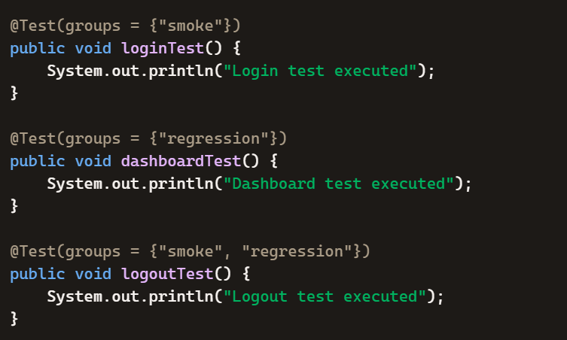
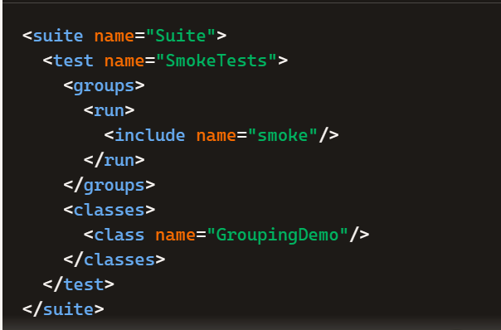
TestNG – Grouping
Grouping allows you to categorize test methods into logical groups using the groups attribute in the @Test annotation.
Helps you run specific sets of tests (like regression, smoke, or sanity) without executing the
entire suite.
Benefit: Makes large test suites easier to manage and execute selectively.
Running Groups via testng.xml

Slide 10
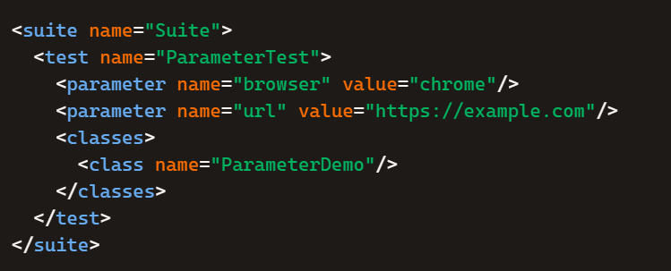
TestNG – Parameterization
Definition: Parameterization allows you to pass values (like browser type, URLs, credentials) into test methods at runtime instead of hardcoding them.
Purpose: Makes tests reusable and configurable without changing code.
Benefit: Helps run the same test across multiple environments or datasets.
1. Using @Parameters (from testng.xml)
You define parameters in your testng.xml file and inject them into test methods.
testng.xml:

Slide 11
TestNG – Parameterization
Here, the browser type and URL are passed from testng.xml.
import org.openqa.selenium.WebDriver;
import org.openqa.selenium.chrome.ChromeDriver;
import org.openqa.selenium.firefox.FirefoxDriver;
import org.testng.annotations.*;
public class ParameterDemo {
WebDriver driver;
@Parameters({"browser", "url"})
@Test
public void launchApp(String browser, String url) {
if(browser.equalsIgnoreCase("chrome")) {
driver = new ChromeDriver();
} else if(browser.equalsIgnoreCase("firefox")) {
driver = new FirefoxDriver();
}
driver.get(url);
driver.quit();
}
}

Slide 12
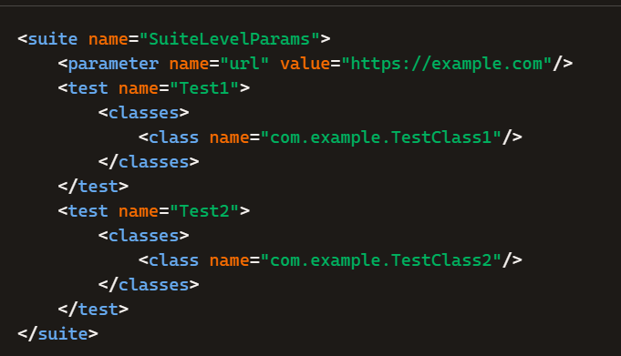
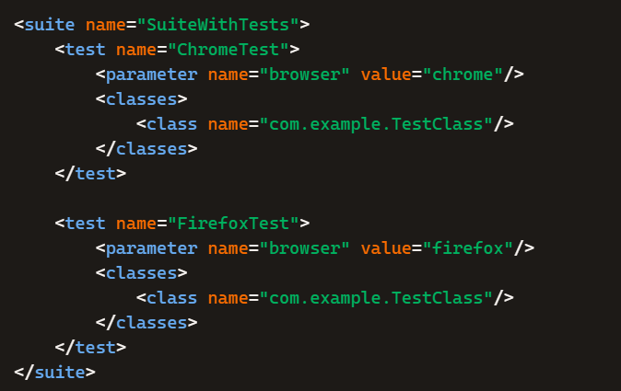
TestNG – Parameterization
In TestNG, parameters can indeed be passed at suite level, test level, or class level, and the scope determines where they are available.
1. Suite Level Parameters
Defined inside the <suite> tag in testng.xml.
Available to all tests and classes inside that suite.
2. Test Level Parameters
Defined inside the <test> tag.
Available only to the classes inside that specific <test> block.

Slide 13
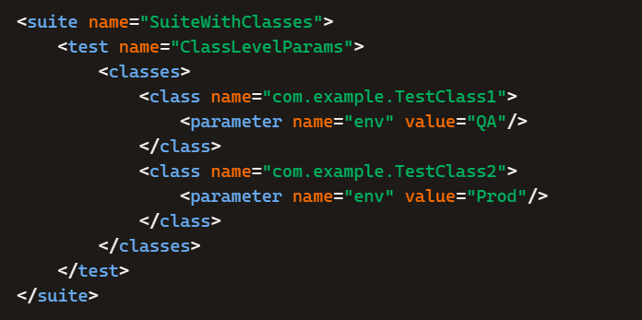
TestNG – Parameterization
3. Class Level Parameters
Defined inside the <class> tag.
Available only to that specific class instance.

Slide 14
TestNG – DataProvider
Definition: @DataProvider is an annotation in TestNG used to supply multiple sets of data to a single test method.
Purpose: It allows the same test to run multiple times with different input values.
Benefit: Eliminates hardcoding and makes tests reusable across datasets.
@DataProvider annotation –
Marks a method as supplying data for a test method. The annotated method must return an Object[][] where each Object[] can be assigned the parameter list of the test method.
The @Test method that wants to receive data from this DataProvider needs to use a dataProvider name equals to the name of this annotation.

Slide 15
TestNG – DataProvider
import org.testng.annotations.*;
public class DataProviderDemo {
// Define DataProvider
@DataProvider(name = "loginData")
public Object[][] getData() {
return new Object[][] {
{"user1", "pass1"},
{"user2", "pass2"},
{"user3", "pass3"}
};
}
// Use DataProvider in Test
@Test(dataProvider = "loginData")
public void loginTest(String username, String password) {
System.out.println("Logging in with: " + username + " / " + password);
// Selenium steps here:
// driver.findElement(By.id("username")).sendKeys(username);
// driver.findElement(By.id("password")).sendKeys(password);
// driver.findElement(By.id("loginBtn")).click();
}
}

Slide 16
TestNG – Parallel Execution
Parallel execution in TestNG allows you to run multiple tests simultaneously across different threads, reducing execution time and speeding up feedback loops.
You can configure parallelism at the suite, test, class, method, or instance level using the parallel attribute in testng.xml
How Parallel Execution Works in TestNG
TestNG provides fine-grained control over parallelism:
Suites → Run multiple suite files in parallel.
Tests → Run different <test> blocks in parallel.
Classes → Run test classes in parallel.
Methods → Run test methods in parallel.
Instances → Run instances of the same class in parallel.

Slide 17
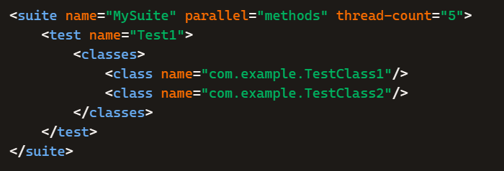
TestNG – Parallel Execution
Example: Parallel Execution in testng.xml
parallel="methods" → Runs all test methods in parallel.
thread-count="5" → Maximum of 5 threads will run simultaneously.

Slide 18
TestNG – Listeners
A Listener in TestNG is an interface that lets you "listen" to events during the test execution lifecycle.
It acts like a hook: whenever a specific event happens (like a test starting, passing, failing, or skipping), the listener can execute custom code.
This is useful for logging, reporting, taking screenshots, or performing actions automatically when tests run.
What is a Listener in TestNG?
A Listener is a special class that monitors the test lifecycle.
It reacts to events like:
onTestStart → when a test begins
onTestSuccess → when a test passes
onTestFailure → when a test fails
onTestSkipped → when a test is skipped
Instead of writing repetitive code inside each test, listeners centralize these actions

Slide 19
TestNG – Listeners
Common Listener Interfaces in TestNG
Listener Interface | Purpose
ITestListener | Tracks test case events (start, success, failure, skip, finish).
ISuiteListener | Tracks suite-level events (before/after suite execution).
IInvokedMethodListener | Tracks before/after each method invocation.
IReporter | Generates custom reports after execution.
IAnnotationTransformer | Modifies annotations at runtime (e.g., change retry logic).

Slide 20
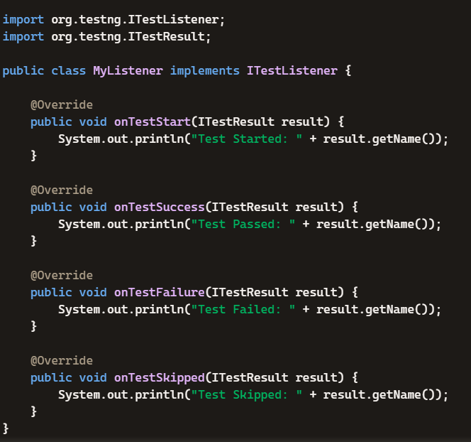
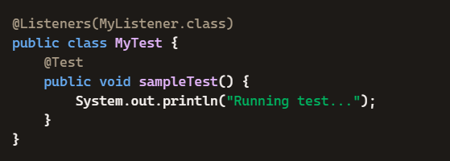


TestNG – Listeners
How to Register a Listener
You can attach listeners in three ways:
Example: Using ITestListener
1.Via @Listeners annotation:
2.Via testng.xml configuration:
3. Programmatically:

Slide 21
TestNG – Listeners
Why Use Listeners?
Logging: Capture detailed logs automatically.
Reporting: Generate custom reports beyond TestNG’s default.
Screenshots: Take screenshots on test failure (common in Selenium).
Retry Mechanism: Re-run failed tests dynamically.
Integration: Hook into CI/CD pipelines with custom actions.

